Slide 1
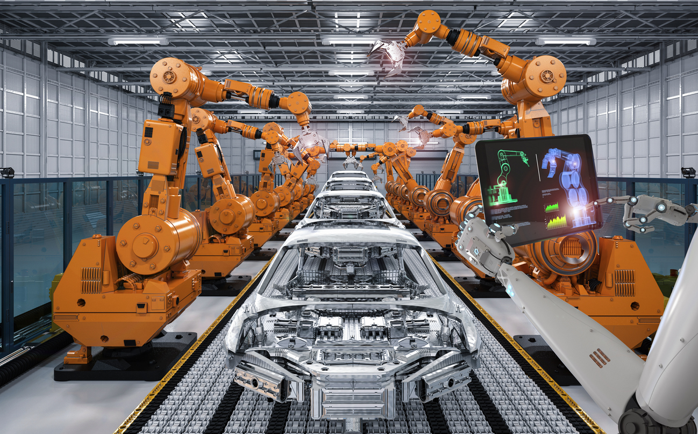
Voice-Controlled
Smart Robotic Arm
using STM32
An Intelligent Automation Solution for Hands-Free Operation

Slide 2
Project Overview
Introduction
Project Vision
Project Objectives
This project presents an innovative approach to industrial automation by integrating voice recognition technology with embedded systems. The smart robotic arm enables hands-free operation through intuitive voice commands, revolutionizing how humans interact with automated machinery.
01
Develop a voice-controlled interface for seamless robotic arm operation
02
Implement real-time command processing using STM32 microcontroller
03
Enable precise pick-and-place operations through servo motor control
Key Innovation
By leveraging the STM32 microcontroller's powerful processing capabilities and Bluetooth connectivity, we've created a system that bridges the gap between complex industrial robotics and user-friendly operation, making automation accessible to non-technical users.
04
Create a scalable platform for industrial automation applications
Core Technology
Connectivity
STM32 + Voice Recognition
Wireless Bluetooth HC-05

Slide 3
Challenges & Needs
Problem Statement
Manual Operation Issues
Critical Need
Continuous Human Effort
Repetitive tasks demand sustained physical and mental attention, leading to decreased productivity over time
Fatigue & Human Error
There is an urgent need for a simple, hands-free, intelligent control system that allows users to operate robotic systems easily and safely.
Operator fatigue significantly increases error rates, compromising quality and safety in critical operations
Hazardous Environment Risks
Chemical labs, high-temperature areas, and electrical zones pose serious safety threats to human operators
"The solution must bridge the gap between sophisticated automation capabilities and intuitive human interaction, making advanced robotics accessible to everyone."
Traditional Robotic Arms
Complex Programming
Require specialized programming knowledge or physical controller interfaces that limit accessibility
Non-Technical Barriers
Impact Areas
Not user-friendly for operators without technical backgrounds, creating adoption challenges
Manufacturing
Healthcare
Research
Education

Slide 4
Our Approach
Proposed Solution
Voice-Controlled
System Architecture
Smart Robotic Arm
1
Voice Input Module
Our solution leverages the STM32 microcontroller as the brain of the system, combined with voice recognition technology to create an intuitive, hands-free control interface for robotic operations.
Mobile app captures voice commands
2
Speech Processing
Converts speech to digital commands
3
STM32 Controller
Key Capabilities
Processes and executes commands
Executes tasks based on voice commands
4
Robotic Actuation
Performs pick-and-place operations automatically
Servo motors execute movements
Reduces human effort and increases efficiency
Safe
Fast
Scalable
Operation
Response
Design

Slide 5
Hardware Components
Components Used
Controller
Communication
Actuators
STM32F446RE
HC-05
4-6 Servos
High-performance ARM Cortex-M4 microcontroller with DSP and FPU capabilities
Bluetooth serial module for wireless communication between mobile app and STM32
MG996R or SG90 servo motors for precise robotic arm movement control
180 MHz max frequency
Bluetooth 2.0 + EDR
180° rotation range
512 KB Flash memory
10m communication range
High torque (MG996R)
128 KB SRAM
9600 baud rate default
Precision positioning
Multiple PWM outputs
UART interface
Quick response time
Mechanical Parts
Power Supply
Input Device
Robotic Arm Structure
5V-6V External Power
Smartphone
Gripper Assembly
Voltage Regulator (if req)
Voice Command App
Mounting Hardware
Power Distribution Board
Bluetooth Enabled

Slide 6
Architecture
System Block Diagram
Complete System Flow
Voice Input
Speech Processing
Communication
STM32 Controller
Motor Driver
Robotic Arm
Mobile / Voice Module
Mobile App / Voice Module
Bluetooth HC-05
F446RE Microcontroller
Servo Motors
+ Gripper
User commands: "Pick", "Place", "Left", "Right"
Converts speech to text/command
Wireless command transmission
Processes command, generates PWM
Controls arm movement
Performs physical task
Input Layer
Processing Layer
Actuation Layer
Voice capture and initial processing through mobile application or dedicated voice recognition module
STM32 microcontroller processes commands and generates precise PWM signals for motor control
Servo motors and gripper execute physical movements with precision and reliability

Slide 7
Hardware Implementation
Circuit Diagram & Connections
HC-05 Bluetooth → STM32
Servo Motors
SIG
PWM
PA0, PA1, PA2, PA3...
TX
PA10
(RX)
VCC
EXT
5-6V External
RX
PA9
(TX)
GND
GND
Common Ground
VCC
5V
Power
GND
GND
Ground
Important Note
Do NOT power servos from STM32 board.
Use external 5-6V power supply for stable operation. Servo motors draw significant current that can damage the microcontroller if powered directly.
Proper Wiring
Safe Power
Reliable Comms
Precise Control

Slide 8
System Operation
Working Principle
Operational Flow
1
2
3
4
5
6
Voice Input
Speech Processing
Bluetooth TX
STM32 Processing
PWM Generation
Arm Movement
User speaks command into mobile app
App converts speech to text command
HC-05 transmits data wirelessly
Controller interprets command
Generate precise PWM signals
Servos execute movement
Real-Time Processing
PWM Precision Control
The STM32 microcontroller processes commands in real-time with minimal latency, ensuring responsive and accurate robotic arm control for time-sensitive operations.
Pulse Width Modulation signals provide precise angular control of servo motors, enabling accurate positioning with resolution down to 0.5 degrees.

Slide 9
Use Cases
Applications
Industrial Automation
Pick and Place Operations
Assembly Line Support
Automated material handling in manufacturing lines with voice-triggered precision movements
Assist workers in repetitive assembly tasks, reducing fatigue and improving consistency
Hazardous Environments
Assistive Technology
Chemical Handling
Safe manipulation of hazardous chemicals without direct human exposure
Physical Assistance
Helping physically challenged individuals perform daily tasks through voice commands
High-Temperature Zones
Home Automation
Operations in extreme heat environments where human presence is dangerous
Voice-controlled manipulation of household objects for enhanced independence

Slide 10
Enhancements
Future Scope
AI Integration
Gesture Control
IoT Connectivity
Advanced Voice Recognition
Hand Gesture Recognition
Cloud Integration
Implement AI-powered natural language processing for complex command understanding
Add gesture-based control as alternative or complementary input method
Connect to cloud platforms for remote monitoring and control
Multi-Language Support
Multi-Modal Interface
Data Analytics
Enable voice commands in multiple languages for global accessibility
Combine voice and gesture for more intuitive and flexible operation
Collect and analyze operational data for optimization
Computer Vision
Industrial Expansion
Object Detection
Visual Feedback
Collaborative Robots
Scalable Networks
Identify and locate objects automatically
Camera-based positioning system
Human-robot collaboration systems
Multiple arm coordination

Slide 11
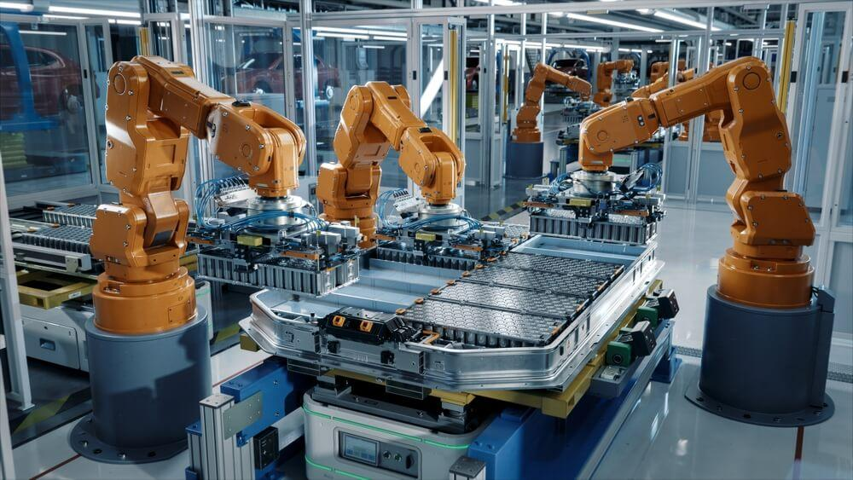
Project Conclusion
Conclusion
The voice-controlled smart robotic arm using STM32 successfully demonstrates an efficient, hands-free automation solution that bridges the gap between complex industrial robotics and intuitive human interaction.
Innovation
Safety
Accessibility
Voice recognition meets embedded systems
Enables operation in hazardous environments
Makes automation user-friendly for all
Thank You
Voice-Controlled Smart Robotic Arm using STM32

